Slide 1
PROJECT TITLE CAPSTONE

Slide 2
iNTRODUCTION
This report provides an analysis of sales data for Capstone Company over the past year. The data was extracted, processed using Python, and visualized using Power BI.

Slide 3
agenda
Analyzed sales
Goal
Methodology

Slide 4
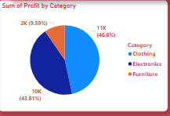
Profit by category

Slide 5
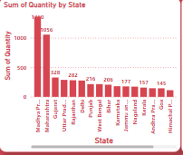
Quantity by state

Slide 6
Effective delivery techniques
Data Extraction
Source: SQL Database
Query: SELECT * FROM Sales WHERE
Tools: SQL Server Management Studio (SSMS)
Data Processing
Language: Python
Libraries: Pandas, NumPy
Data Cleaning: Removed duplicates and handled missing values.
Data Transformation: Aggregated sales data by month and product category.
Data Analysis: Calculated total sales, average sales, and growth rate.

Slide 7
Data Visualization
Tool: Power BI
Visuals:
Line Chart: Monthly Sales Trends
Bar Chart: Sales by Product Category
Pie Chart: Market Share by Region

Slide 8
INSIGHT
Top Performing Product: Product CLOTHING had the highest sales, contributing of total revenue.
.
Regional Performance: Region Mahdya Pradesh showed the highest Quantity

Slide 9
CONCLUSION
The analysis highlights key areas of growth and opportunities for improvement. By leveraging SQL for data extraction, Python for data processing, and Power BI for visualization, we can gain valuable insights to drive business decisions.

